Slide 1

Compiler Design : Lexical and Syntax Analysis
Sabrina Tarin Chowdhury

Slide 2
Stages of Compiler Design
Lexical Analysis: The first stage of compiler design is lexical analysis, also known as scanning. In this stage, the compiler reads the source code character by character and breaks it down into a series of tokens, such as keywords, identifiers, and operators. These tokens are then passed on to the next stage of the compilation process.
Syntax Analysis: The second stage of compiler design is syntax analysis, also known as parsing. In this stage, the compiler checks the syntax of the source code to ensure that it conforms to the rules of the programming language. The compiler builds a parse tree, which is a hierarchical representation of the program’s structure, and uses it to check for syntax errors.

Slide 3
Stages of Compiler Design
Semantic Analysis: The third stage of compiler design is semantic analysis. In this stage, the compiler checks the meaning of the source code to ensure that it makes sense. The compiler performs type checking, which ensures that variables are used correctly and that operations are performed on compatible data types. The compiler also checks for other semantic errors, such as undeclared variables and incorrect function calls.
Code Generation: The fourth stage of compiler design is code generation. In this stage, the compiler translates the parse tree into machine code that can be executed by the computer. The code generated by the compiler must be efficient and optimized for the target platform.
Optimization: The final stage of compiler design is optimization. In this stage, the compiler analyzes the generated code and makes optimizations to improve its performance. The compiler may perform optimizations such as constant folding, loop unrolling, and function in lining.

Slide 4
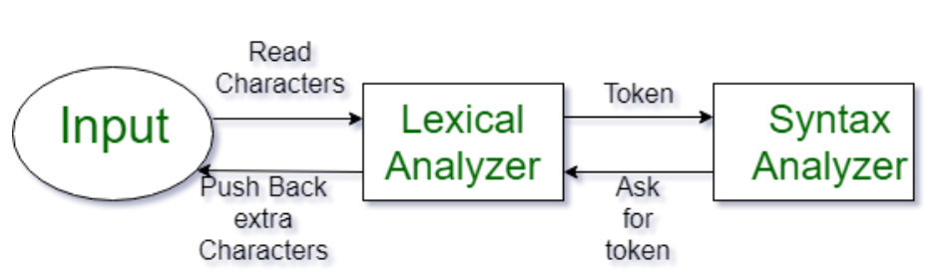
Lexical and Syntax analysis
Lexical Analysis first phase of the compiler
Also known as a scanner.
Converts the High level input program into a sequence of Tokens

Slide 5
Vocabulary
Lexemes are the smallest units of the language.
Example: I like pizza.
Example: sum = 2 + score * 5;

Slide 6
Vocabulary
A token is a pair consisting of a token name and an optional attribute value.
It contains both lexemes and token id.
int a = 10; //Input Source code
Tokens
Name ID
int (keyword)
a (identifier)
= (operator)
10 (constant)
; (punctuation-semicolon)

Slide 7
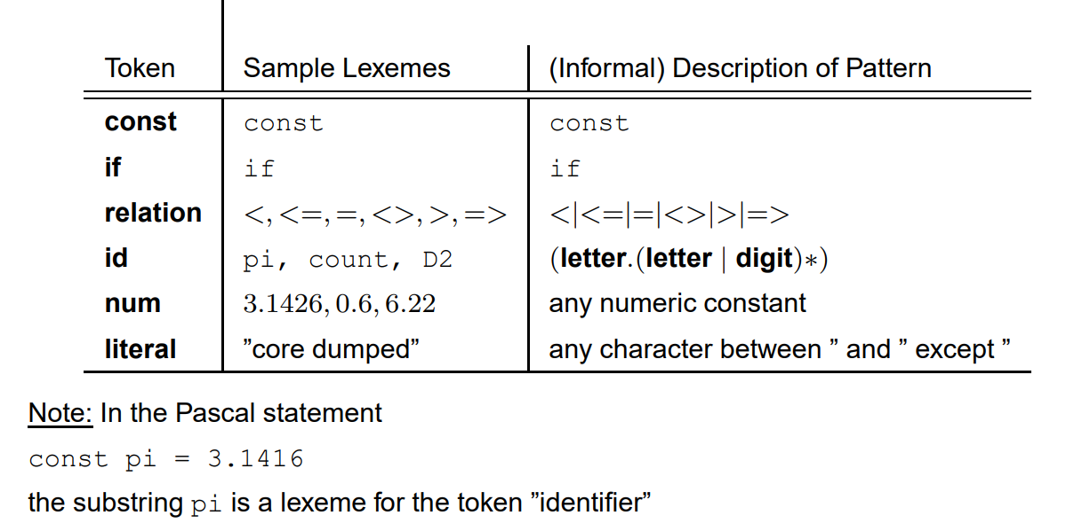
Example

Slide 8
How Lexical Analyzer works
Input preprocessing: This stage involves cleaning up the input text and preparing it for lexical analysis. This may include removing comments, whitespace, and other non-essential characters from the input text.
Tokenization: This is the process of breaking the input text into a sequence of tokens. This is usually done by matching the characters in the input text against a set of patterns or regular expressions that define the different types of tokens.

Slide 9
How Lexical Analyzer works
3. Token classification: In this stage, the lexer determines the type of each token. For example, in a programming language, the lexer might classify keywords, identifiers, operators, and punctuation symbols as separate token types.
4. Token validation: In this stage, the lexer checks that each token is valid according to the rules of the programming language. For example, it might check that a variable name is a valid identifier, or that an operator has the correct syntax.
5. Output generation: In this final stage, the lexer generates the output of the lexical analysis process, which is typically a list of tokens. This list of tokens can then be passed to the next stage of compilation or interpretation.

Slide 10
Syntax Analysis

Slide 11

What is Syntax?
The set of rules that describe the language
Why do we need to be able to describe syntax?
To implement the language
To be able to read specifications about the language

Slide 12
Syntax Analysis
Syntax analysis is a process in compiler design where the compiler checks if the source code follows the grammatical rules of the programming language.
This is typically the second stage of the compilation process, following lexical analysis.
The main goal of syntax analysis is to create a parse tree or abstract syntax tree (AST) of the source code, which is a hierarchical representation of the source code that reflects the grammatical structure of the program.

Slide 13
How Syntax Analysis Done
It checks the syntactical structure of the given input, i.e. whether the given input is in the correct syntax (of the language in which the input has been written) or not.
It does so by building a data structure, called a Parse tree or Syntax tree.
The parse tree is constructed by using the pre-defined Grammar of the language and the input string.
If the given input string can be produced with the help of the syntax tree (in the derivation process), the input string is found to be in the correct syntax. if not, the error is reported by the syntax analyzer.

Slide 14
Types of Parsing Algorithm
LL parsing: This is a top-down parsing algorithm that starts with the root of the parse tree and constructs the tree by successively expanding non-terminals. LL parsing is known for its simplicity and ease of implementation.
LR parsing: This is a bottom-up parsing algorithm that starts with the leaves of the parse tree and constructs the tree by successively reducing terminals. LR parsing is more powerful than LL parsing and can handle a larger class of grammars.

Slide 15
Types of Parsing Algorithm
LR(1) parsing: This is a variant of LR parsing that uses lookahead to disambiguate the grammar.
LALR parsing: This is a variant of LR parsing that uses a reduced set of lookahead symbols to reduce the number of states in the LR parser.

Slide 16
Features of Syntax Analysis:
Syntax Trees: Syntax analysis creates a syntax tree, which is a hierarchical representation of the code’s structure. The tree shows the relationship between the various parts of the code, including statements, expressions, and operators.
Context-Free Grammar: Syntax analysis uses context-free grammar to define the syntax of the programming language. Context-free grammar is a formal language used to describe the structure of programming languages.

Slide 17
Features of Syntax Analysis:
Top-Down and Bottom-Up Parsing: Syntax analysis can be performed using two main approaches: top-down parsing and bottom-up parsing. Top-down parsing starts from the highest level of the syntax tree and works its way down, while bottom-up parsing starts from the lowest level and works its way up.
Error Detection: Syntax analysis is responsible for detecting syntax errors in the code. If the code does not conform to the rules of the programming language, the parser will report an error and halt the compilation process.

Slide 18
Features of Syntax Analysis:
Intermediate Code Generation: Syntax analysis generates an intermediate representation of the code, which is used by the subsequent phases of the compiler. The intermediate representation is usually a more abstract form of the code, which is easier to work with than the original source code.
Optimization: Syntax analysis can perform basic optimizations on the code, such as removing redundant code and simplifying expressions.

Slide 19
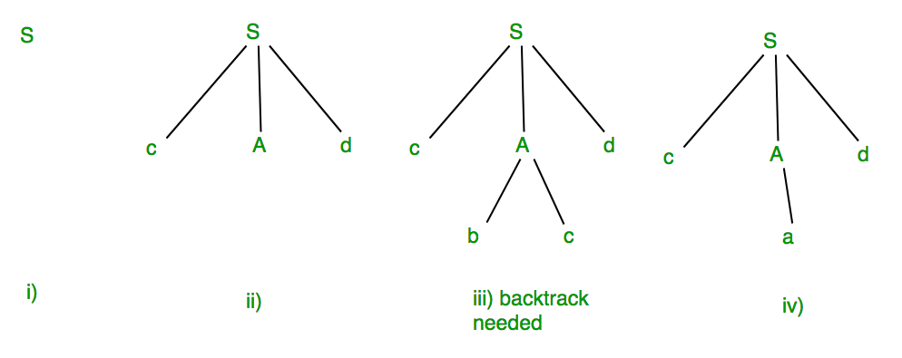
Context Free Grammer
Context Free Grammar is formal grammar
Syntax or structure of a formal language can be described using context-free grammar (CFG)
Example: Suppose production rules for the Grammar of a language are:
S -> cAd
A -> bc|a
So the possible
strings are
‘S’, ‘cAd’, ‘cbcd’ and ‘cad’

Slide 20
Context-Free Grammars (CFG)
John Backus was the inventor of Fortran (won the ACM Turing Award in 1977)
John Backus and Peter Naur used the BNF form for Algol
Peter Naur also won the ACM Turing Award in 2005 for
Report on the Algorithmic Language ALGOL 60
BNF was named by Donald Knuth

Slide 21
Context-Free Grammars (CFG)
Backus–Naur Form (BNF) notation for CFG:
expr → id | number | - expr | ( expr ) | expr op expr
op → + | - | * | /
Each of the rules in a CFG is known as a production
The symbols on the left-hand sides of the productions are
nonterminals (or variables)
A CFG consists of:
a set of terminals/tokens T (that cannot appear on the left-hand side of any production)
a set of non-terminals N
a non-terminal start symbol S, and
a set of productions
7

Slide 22
An Example: Arithmetic Expressions
Terminals: id, ‘+’, ‘-’, ‘*’, ‘/’, ‘(’, ‘)’
Nonterminals: expr, op
Productions:
expr → expr op expr expr → ‘(’ expr ‘)’ expr → ‘-’ expr
expr → id
op → ‘+’ | ‘-’ | ‘*’ | ‘/’
Start symbol: expr

Slide 23
An Example: Arithmetic Expressions
expr → id
id ⇒ { id },
‘+’ ⇒ { + },
‘-’ ⇒ { - },
‘*’ ⇒ { * },
‘/’ ⇒ { / },
‘(’ ⇒ { ( },
‘)’ ⇒ { ) },
op ⇒ { +, -, *, / },
expr ⇒ { id, - id, ( id ), id + id, id - id, … }.
expr → ‘-’ expr
expr → - id
expr → ‘(’ expr ‘)’
expr → (id)
expr → expr op expr expr → id + id

Slide 24
Derivations
A derivation step is an application of a production as a rewriting rule, namely, replacing a nonterminal in the string by one of its right-hand sides, N → α
… N … ⇒ … α …
Starting with the start symbol, a sequence of derivation steps is called a derivation
S ⇒ … ⇒ α
or S ⇒* α

Slide 25
An Example
Grammar:
expr → expr op expr
expr → ‘(’ expr ‘)’
expr → ‘-’ expr
expr → id
5. op → ‘+’
6. op → ‘-’
7. op → ‘*’
8. op → ‘/’
Derivation:
expr
⇒ - expr
⇒ - (expr )
⇒ - (expr op expr )
⇒ - ( id op expr )
⇒ - ( id + expr )
⇒ - ( id + id )

Slide 26
Left- & Right-Most Derivations
If there are more than one nonterminal in the string, many choices are possible
A leftmost derivation always chooses the leftmost nonterminal to rewrite
A rightmost derivation always chooses the rightmost nonterminal to rewrite

Slide 27
An Example
Leftmost derivation:
expr
⇒ - expr
⇒ - (expr )
⇒ - (expr op expr )
⇒ - (id op expr )
⇒ - ( id + expr )
⇒ - ( id + id )
Rightmost derivation:
expr
⇒ - expr
⇒ - (expr )
⇒ - (expr op expr )
⇒ - (expr op id)
⇒ - (expr + id )
⇒ - ( id + id )

Slide 28
Context-Free Grammars (CFG)
Example: we can use our grammar for expressions to generate the
string “slope * x + intercept”:
expr ⇒ expr op expr
⇒ expr op id
⇒ expr + id
⇒ expr op expr + id
⇒ expr op id + id
⇒ expr * id + id
⇒ id * id + id
⇒ id(slope)* id(x)+ id(intercept)
Grammar:
expr → id | number
| - expr | ( expr )
| expr op expr op → + | - | * | /
Notes: The ⇒ metasymbol is often pronounced “derives”
A series of replacement operations that shows how to derive a string of terminals from the start symbol is called a derivation
Each string of symbols along the way is called a sentential form
The final sentential form, consisting of only terminals, is called the yield of the
derivation

Slide 29
Symbol Table
A Symbol table is a data structure used by the compiler, where each identifier in program’s source code is stored along with information associated with it relating to its declaration. It stores identifier as well as it’s associated attributes like scope, type, line-number of occurrence, etc.
Symbol table can be implemented using various data structures like:
LinkedList
Hash Table
Tree

Slide 30
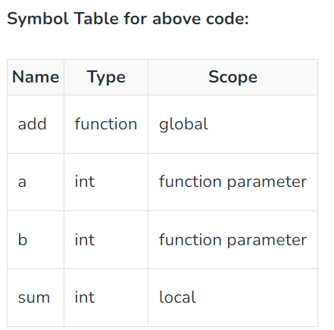
Symbol Table
// Define a global function int add(int a, int b) { int sum = 0; sum = a + b; return sum; }

Slide 31
Let’s Review!
What are lexemes?
What are tokens?
Consider the grammar:
S -> AB
A -> aa
B -> b
Nonterminals? Terminals? Describe the set of all strings that can be derived using this grammar.

Slide 32
Context Free Grammar, Example
Let’s Review!
S -> aBc
B-> bBb | λ
Nonterminals?
Terminals?
Set of all strings?

Slide 33
Advantages
Advantages of using syntax analysis in compiler design include:
Structural validation: Syntax analysis allows the compiler to check if the source code follows the grammatical rules of the programming language, which helps to detect and report errors in the source code.
Improved code generation: Syntax analysis can generate a parse tree or abstract syntax tree (AST) of the source code, which can be used in the code generation phase of the compiler design to generate more efficient and optimized code.
Easier semantic analysis: Once the parse tree or AST is constructed, the compiler can perform semantic analysis more easily, as it can rely on the structural information provided by the parse tree or AST.

Slide 34
Disadvantage
Complexity: Parsing is a complex process, and the quality of the parser can greatly impact the performance of the resulting code. Implementing a parser for a complex programming language can be a challenging task, especially for languages with ambiguous grammars.
Reduced performance: Syntax analysis can add overhead to the compilation process, which can reduce the performance of the compiler.
Limited error recovery: Syntax analysis algorithms may not be able to recover from errors in the source code, which can lead to incomplete or incorrect parse trees and make it difficult for the compiler to continue the compilation process.
Inability to handle all languages: Not all languages have formal grammars, and some languages may not be easily pursuable.

Slide 35
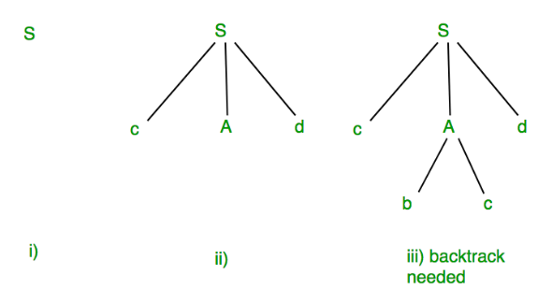
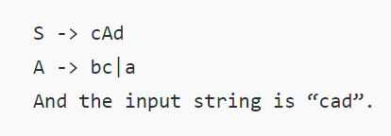
Concepts of FIRST and FOLLOW sets in Compiler Design
Lets consider the following grammar
Is cad a valid input?
First it checks the strings
In step (iii) above, the production rule A->bc was not a suitable one to apply (because the string produced is “cbcd” not “cad”), here the parser needs to backtrack.
apply the next production rule available with A which is shown in step (iv), and the string “cad” is produced.

Slide 36
Concepts of FIRST and FOLLOW sets in Compiler Design
Thus, the given input can be produced by the given grammar, therefore the input is correct in syntax. But backtrack was needed to get the correct syntax tree, which is really a complex process to implement.
There can be an easier way to solve this, which we shall see in the next article “Concepts of FIRST and FOLLOW sets in Compiler Design”.

Slide 37
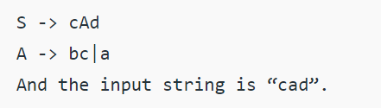
Concepts of FIRST and FOLLOW sets in Compiler Design
If the compiler would have come to know in advance, that what is the “first character of the string produced when a production rule is applied”,
Comparing it to the current character or token in the input string it sees, it can wisely take decision on which production rule to apply.

Slide 38
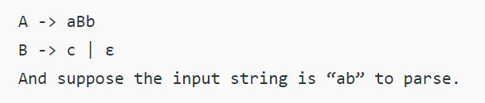
Why Follow
The parser faces one more problem. Let us consider below grammar to understand this problem.
As the first character in the input is a, the parser applies the rule A->aBb.

Slide 39
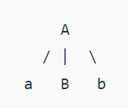
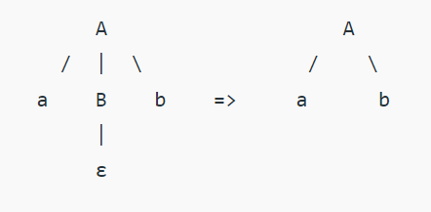
Why Follow
.
Parser checks for the second character of the input string which is b, and the Non-Terminal to derive is B
but the parser can’t get any string derivable from B that contains b as first character.
But the Grammar does contain a production rule B -> ε, if that is applied then B will vanish, and the parser gets the input “ab”, as shown below.

Slide 40
Why Follow
.
In RHS of A -> aBb, b follows Non-Terminal B, i.e. FOLLOW(B) = {b}, and the current input character read is also b. Hence the parser applies this rule. And it is able to get the string “ab” from the given grammar.
So FOLLOW can make a Non-terminal vanish out if needed to generate the string from the parse tree.

Slide 41
Grammar for a Small Language
<program> -> begin <stmt_list> end
<stmt_list> -> <stmt> | <stmt>; <stmt_list>
<stmt> -> <assign> ( or if-statement or loop etc.)
So why do some PLs use semicolons? And how do those that don’t, work?

Slide 42
Grammar for Simple Assignment Statements
<assign> -> <id> = <expr>
<id> -> A | B | C
<expr> -> <id> + <expr> |
<id> * <expr> |
(<expr>) |
<id>
Do a derivation for: A = B+C
Do a derivation for: A =
B * (A + C)

Slide 43
Solution
<assign> => <id> = <expr>
=> A = <expr>
=> A = <id> * <expr>
=> A = B * <expr>
=> A = B * ( <expr> )
=> A = B * ( <id> + <expr> )
=> A = B * (A + <expr> )
=> A = B * ( A + <id> )
=> A = B * ( A + C)

Slide 44
Parse Trees
A parse tree is a graphical representation for a derivation that filters out the order of choosing nonterminals for rewriting
Many derivations may correspond to the same parse tree, but every parse tree has associated with it a unique leftmost and a unique rightmost derivation

Slide 45
An Example
Leftmost derivation:
expr
⇒ - expr
⇒ - (expr )
⇒ - (expr op expr )
⇒ - (id op expr )
Rightmost derivation:
expr
⇒ - expr
⇒ - (expr )
⇒ - (expr op expr )
⇒ - (expr op id)
⇒ - (expr + id )
expr
- expr
⇒ - ( id + expr )
⇒ - ( id + id )
( expr )
expr op expr
id + id
⇒ - ( id + id )

Slide 46
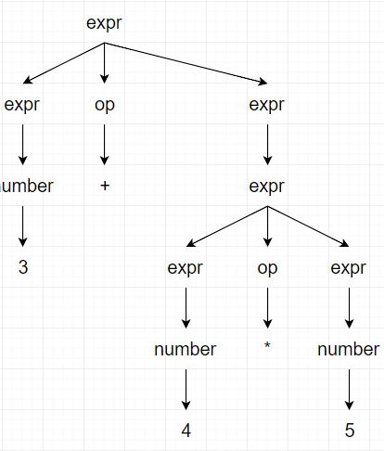
Derivations and Parse Trees
We can represent a derivation graphically as a parse tree
The root of the parse tree is the start symbol of the grammar
The leaves are its yield
Each node with its children represent a
production
E.g.,The parse tree for the expression grammar for
3 + 4 * 5 is:

Slide 47
Ambiguous Grammars
A grammar is ambiguous if it can derive a string with two different parse trees
If we use the syntactic structure of a parse tree to interpret the meaning of the string, the two parse trees have different meanings
Since compilers do use parse trees to derive meaning, we would prefer to have unambiguous grammars

Slide 48
An Example
id + id * id
expr
expr
expr
+
expr
expr
*
expr
id
expr
*
expr
expr
+
expr
id
id
id
id
id

Slide 49
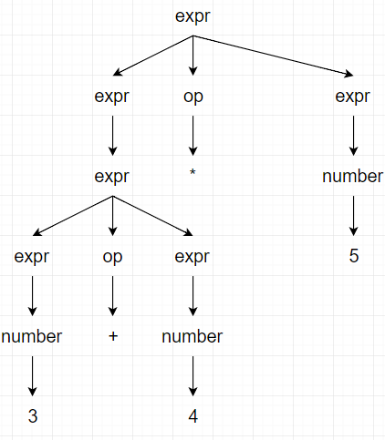
Derivations and Parse Trees
The example grammar is ambiguous (it can generate multiple parse trees for 3+4*5): one corresponds to 3+(4*5) and one corresponds to (3+4)*5
Grammar:
expr → id | number
| - expr | ( expr )
| expr op expr op → + | - | * | /
Elsevier

Slide 50
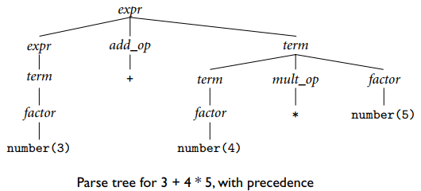
Context free grammars
A better version of our expression grammar should include precedence and associativity:
expr → term | expr add_op term term → factor | term mult_op factor
factor → id | number | - factor | ( expr )
add_op → + | -
mult_op → * | /

Slide 51
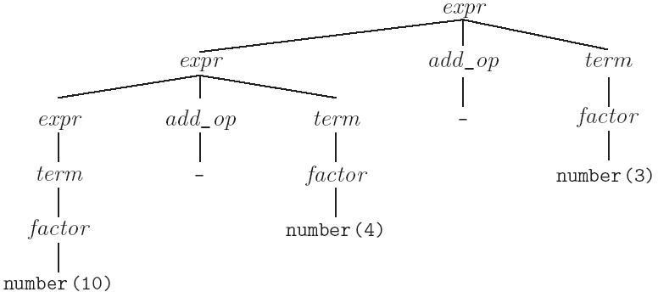
Context free grammars
Parse tree for expression grammar for 10 - 4 - 3
expr → term | expr add_op term term → factor | term mult_op factor
factor → id | number | - factor | ( expr )
add_op → + | -
mult_op → * | /
has left associativity
16

Slide 52
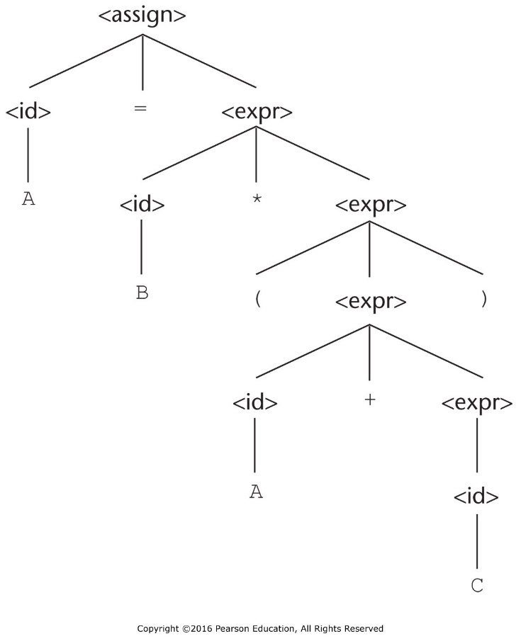
Parse Trees
Leaves are terminals, internal nodes are non terminals
Figure 3.1 A parse tree for the simple statement A = B * (A + C)
<assign> => <id> = <expr>
=> A = <expr>
=> A = <id> * <expr>
=> A = B * <expr>
=> A = B * ( <expr> )
=> A = B * ( <id> + <expr> )
=> A = B * (A + <expr> )
=> A = B * ( A + <id> )
=> A = B * ( A + C)

